Slide 1
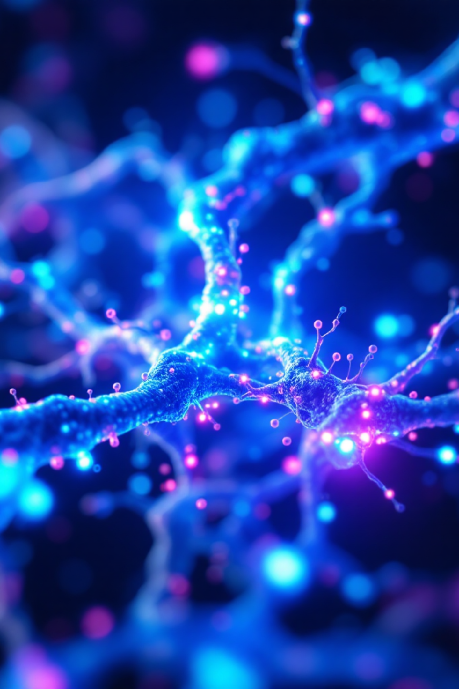

Lithium and Alzheimer's Disease Prevention
A Clinical Summary for Healthcare Providers
CLINICAL GUIDANCE
EVIDENCE-BASED

Slide 2
Landmark Discovery
The Breakthrough
A 2025 Nature study revealed lithium is the only metal significantly reduced in brains of people with early cognitive impairment.
Brain Deficiency
Plaque Trapping
Lithium levels drop in early AD
Amyloid plaques sequester lithium
Neuroprotection
Lithium orotate bypasses trapping

Slide 3
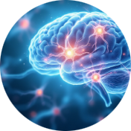

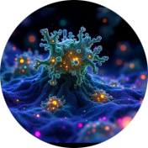

Evidence Strength
Seven key hypotheses were systematically evaluated following PRISMA guidelines, revealing strong support for lithium's neuroprotective potential.
Neuroprotective Effects
Brain Lithium Reduction
Plaque Sequestration
Orotate Superiority
Verified - High ConfidenceMultiple studies confirm lithium protects brain tissue
Verified - High ConfidenceAD patients show significantly lower brain lithium
Verified - High ConfidencePlaques trap lithium, reducing availability
Verified - Moderate ConfidenceAnimal studies show orotate outperforms carbonate

Slide 4
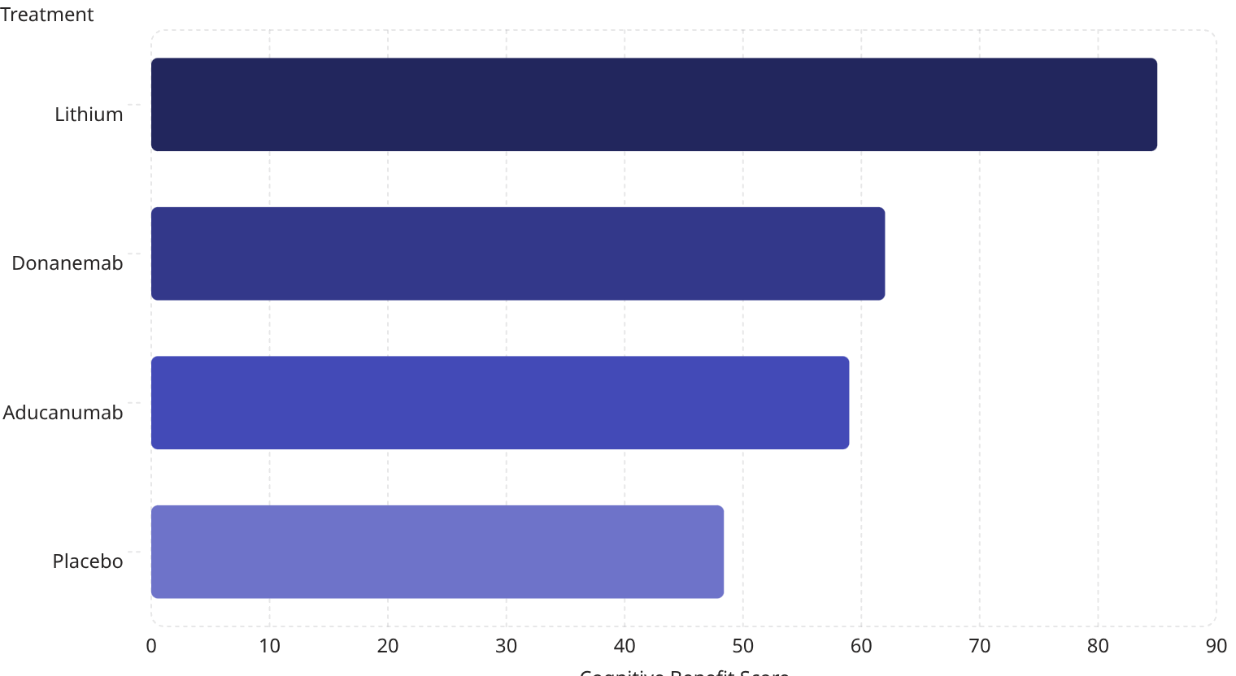
Clinical Evidence
Meta-Analysis Results
Three randomized controlled trials (n=199) demonstrated significant cognitive benefits with lithium treatment.
17%
-0.41
Risk Reduction
Effect Size
Lower dementia risk with higher natural lithium exposure
Standardized mean difference (95% CI: -0.81 to -0.02, p=0.04)
Network meta-analysis shows lithium significantly outperformed FDA-approved antibodies on cognitive measures.

Slide 5
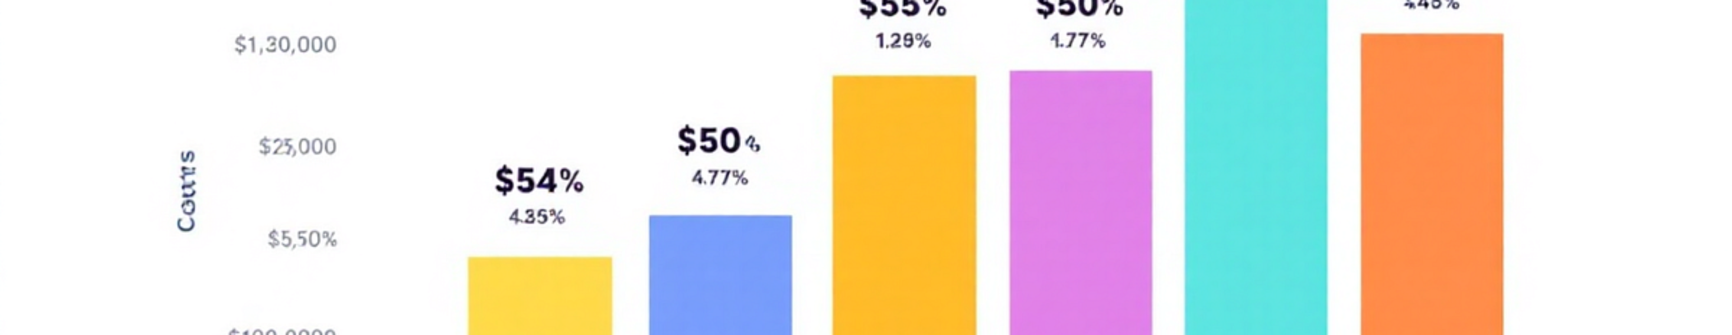
Lithium vs. FDA-Approved Treatments
Annual Cost
Administration
Safety Profile
Infrastructure
Lithium: ~$100
Anti-amyloid antibodies: $26,000-32,000
Lithium: Oral daily
Antibodies: IV infusion biweekly
Lithium: 60+ years data
Antibodies: ARIA risk (brain edema)
Lithium: Minimal
Antibodies: PET imaging, infusion centers

Slide 6
Critical Evidence Gaps
Despite promising findings, significant questions remain unanswered before clinical recommendations can be made.
No Human Trials of Lithium Orotate
Optimal Dosing Unknown
Long-Term Safety Unclear
Translation Uncertainty
Current supplement doses (~5mg) are arbitrary, not evidence-based. Safe and effective human dosing requires clinical trials.
Safety profile of lithium orotate for chronic use in older adults remains uncharacterized.
Murine model benefits may not replicate in human populations with complex AD pathology.
The superior formulation identified in animal studies has never been tested in humans for cognitive protection.

Slide 7





Current Clinical Recommendation
Do NOT Recommend Lithium Orotate for Dementia Prevention
Dr. Bruce Yankner (Study Author): "Before recommending lithium orotate, we need to determine the effective and safe dose range in people. We are planning a clinical trial that will hopefully begin in the near future."
Dosing Unclear
Quality Variable
No evidence-based dosing guidelines exist
Supplements lack pharmaceutical-grade standards
Drug Interactions
Monitoring Required
Conflicts with ACE inhibitors, ARBs, NSAIDs, diuretics
Renal and thyroid function need periodic assessment

Slide 8
Patient Counseling Framework
01
02
Acknowledge
Explain
Recognize the promising research foundation and patient interest
Clinical trials required before formal recommendations possible
03
04
Review Risks
Clarify
Nephrotoxicity, thyroid dysfunction, dehydration sensitivity, drug interactions
Lithium carbonate (established safety data) may not be optimal formulation
05
06
Monitor
Document
If patient proceeds: baseline and periodic (q3-6 month) kidney and thyroid function
Record shared decision-making conversation in medical record

Slide 9
Ongoing Research Pipeline
Trials to Monitor
Research Priorities
Harvard Phase 1/2
1
1
2
Lithium orotate trial (Yankner) - Planning stage
Human Pharmacokinetics
Phase 2 Efficacy
2
LATTICE Study
Phase 1 dose-ranging study of lithium orotate
Biomarker-endpoint RCT
University of Pittsburgh RCT, n=80, 2 years with advanced imaging
Lahai Health
3
3
4
Feasibility study, n=20-30, 12 months - IRB pending
Long-Term Safety
Target Engagement
4
Biomarker Studies
Extended follow-up studies
Brain lithium MRI spectroscopy
Funding Challenge: Generic compound without patent protection makes pharmaceutical investment unlikely. Public and philanthropic funding essential.
p-tau217 surrogate endpoints - Multiple sites

Slide 10

Key Takeaways
Strong Scientific Foundation
Premature for Clinical Use
Evidence for lithium's neuroprotective properties is substantial, with high-confidence findings on brain deficiency in AD.
Without Phase 3 trials establishing optimal dosing and long-term safety, routine use cannot be recommended.
Engage Informed Discussions
Healthcare providers should acknowledge patient interest while emphasizing need for ongoing research and safety monitoring.
Monitor emerging trial results and maintain evidence-based approach to patient counseling.

